Slide 1
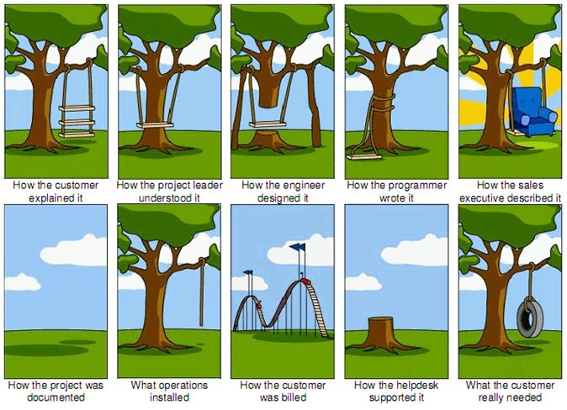

Slide 2
Introduction
Requirements engineering helps software engineers to better understand the problem they are to solve.
Who does it?
Software engineers (system analysts) and other project stakeholders e.g. managers, customers, end-users, etc.
Why is it important?
It is important to understand what the customer wants.

Slide 3
Requirement Analysis
Requirement Analysis the process of discovering, refinement, modeling and specification in a software project.
Will always involve both the customer and system engineer, allowing the system engineer to achieve a set of objectives:
Specify software function and performance
Indicate software interface with other system elements
Establish design constraints that the software must meet

Slide 4
Requirement Analysis
Requirement Analysis is also concerned with the preparation of the Software Specification:
A formal document that specifies in precise terms the functional and performance requirements of the software.
Specification document in turn will allow the developer and customer to assess quality once the software itself has been built.
The software developer performing Requirement analysis would often be known as the analyst.

Slide 5
Analysis Tasks
Software requirement analysis can be divided into an ordered sequence of five main areas of effort, namely:
Problem Recognition
Evaluation and Synthesis
Modeling
Specification
Review

Slide 6
Problem Recognition
Goal of analyst here is recognition of the basic problem elements as perceived by user and customer
Understand software in the system context
Define software scope
Analyst will also need to establish contact with management and technical staff of the customer and software development organization

Slide 7
Evaluation and Synthesis
The analyst must now evaluate the flow and content of information
Define and elaborate all software functions
Understand software behavior in the context of events that affect the system
Establish system interface characteristics and uncover design constraints
Throughout this step, the emphasis is on what must be done, not how it will be done
This step will continue until both the analyst and customer feels confident that software can be adequately specified for subsequent development steps.

Slide 8
Modeling
The analyst will then create models of the system that will enable better understanding of data and control flow.
Models serve a number of important roles:
Aids in understanding the information, function and behavior of a system.
Makes requirement analysis task easier and more systematic
It serves as a basis for creating specification for the software.
Becomes the focal point for review
Becomes the foundation for design

Slide 9
Specification
The specification is a representation of software that can be reviewed and approved by the customer.
Usually developed as a joint effort between the developer and the customer.

Slide 10
Specification Principles
Separate functionality from implementation
A process-oriented systems specification language is required
A specification must encompass the environment in which the system operates
A specification must be a cognitive model
A specification must be operational
A specification must be tolerant of incompleteness and augmentable
A specification must be localized and loosely coupled

Slide 11
Review
Review of analysis documents like specification.
Review should first be conducted at a macroscopic level
Conducted by customer and developer.
Results in modifications to:
Functions
Performance
Information representation
Constraints
Validation criteria

Slide 12
The Analyst
The basic responsibility of the analyst can be said to be the following:
To analyze and define systems of optimum performance, i.e. an output that fully meets management objectives
The analyst must also exhibit the ability to:
Grasp abstract concept, partition them and generate solutions based on each division
Understand implicit information, separate them and treat them individually
Absorb pertinent facts from conflicting sources
Understand the customer environment
Apply hardware and/or software system elements to the customer environment
Communicate well in written and verbal form

Slide 13
Problems in Requirement Analysis
Requirement analysis is a communication-intensive activity. i.e. where communication is concerned, noise, i.e. miscommunication, will always occur.
Thus problems like miscommunication and omission often occur between analyst and customer.
Successful acquisition of information cannot be guaranteed.
Analyst have difficulties:
In getting pertinent (appropriate) information
Handling large and complex problems, i.e. as complexity increases, effort increases
Accommodating changes that occur during and after analysis

Slide 14
Causes for the Problems
Poor communication that makes information acquisition difficult
Inadequate techniques and tools for developing specification
Tendency to take short-cuts during requirements analysis tasks, leading to unstable design
Failure to consider alternative solutions before software is specified on both parts of analyst and customer. i.e. are there better ways to do this?

Slide 15
Functional Requirement
Functional requirement defines a function of a system or its component, where a function is described as a specification of behavior between outputs and inputs.
involve calculations, technical details, data manipulation and processing, and other specific functionality that define what a system is supposed to accomplish.

Slide 16
Functional Requirement
Describe the behavior of system
Support users goals, tasks or activities
Detailed and specified in the system design
It contain unique name and number
Helps to reader to understand why requirement is needed.

Slide 17
Functional Requirement Should Include
Description of data to be entered
Description of operation performed by each screen
Description of work flows performed by the system
Who can enter the data into a system

Slide 18
Non Functional Requirement
How system works?
It make system more tangible
Related the usability of system
Judge the operation of system, rather than specific behaviors

Slide 19
Non Functional Requirement Should Include
Usability
Reliability
Performance
Supportability

Slide 20
Security
Logging
Storage
Configuration
Performance
Cost
Interoperability
Flexibility
Disaster recovery
Accessibility

Slide 21
Software Requirement
The software requirements are description of features and functionalities of the target system
Requirements convey the expectations of users from the software product.

Slide 22
Requirement Engineering Process
Feasibility Study
Requirement Gathering
Software Requirement Specification
Software Requirement Validation

Slide 23
Software Requirements Characteristics
Clear
Correct
Consistent
Coherent(Logical)
Comprehensible
Modifiable
Verifiable
Prioritized
Unambiguous(specific)
Traceable
Credible source

Slide 24
User Requirement
easy to operate
quick in response
effectively handling operational errors
providing simple yet consistent user interface

Slide 25
System Requirement
System requirements are the configuration that a system must have in order for a hardware or software application to run smoothly and efficiently

Slide 26
Software Requirement Documentation
All the expected functionalities out of the application are documented in terms of “Requirements” and this document is called a Requirement document

